Slide 1
Computer Programming
Mohammed Hassan

Slide 2
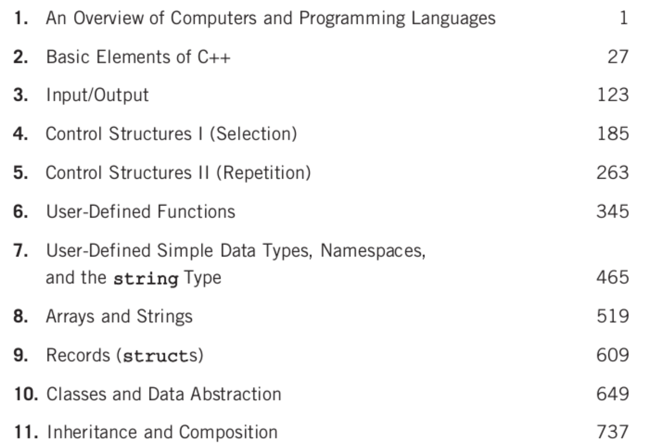
Course Outline

Slide 3

Basic Elements of C++

Slide 4
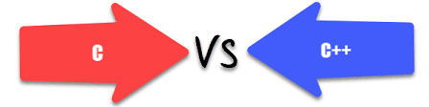
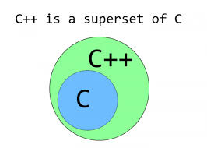

Slide 5
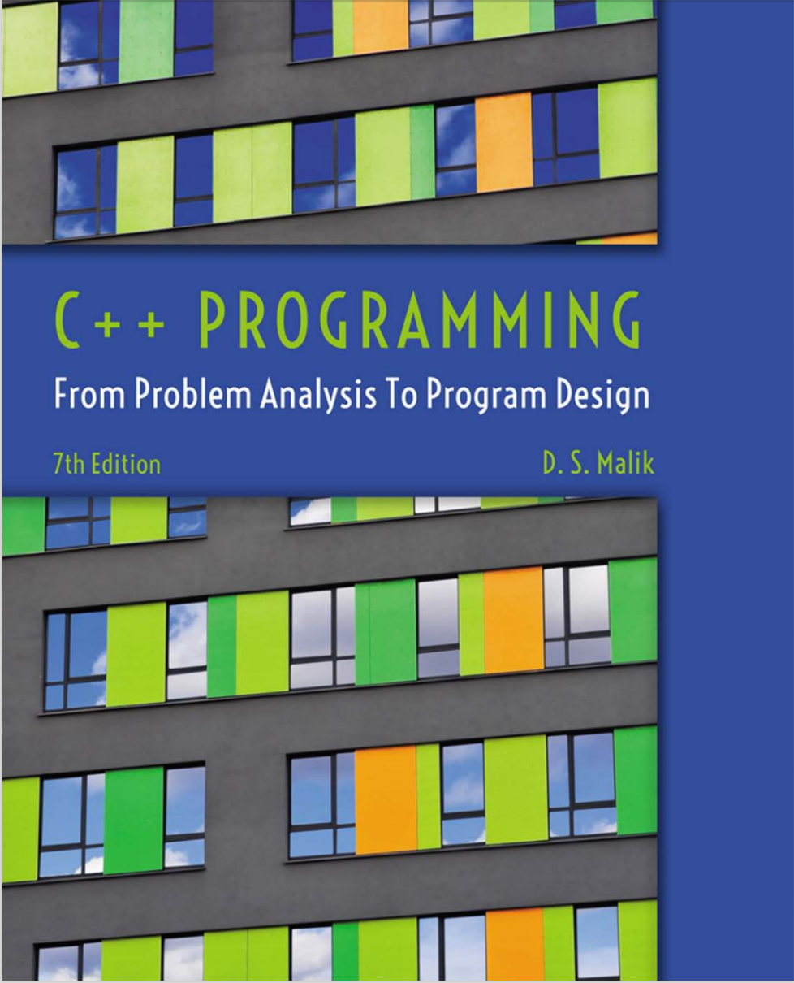
Course Material

Slide 6
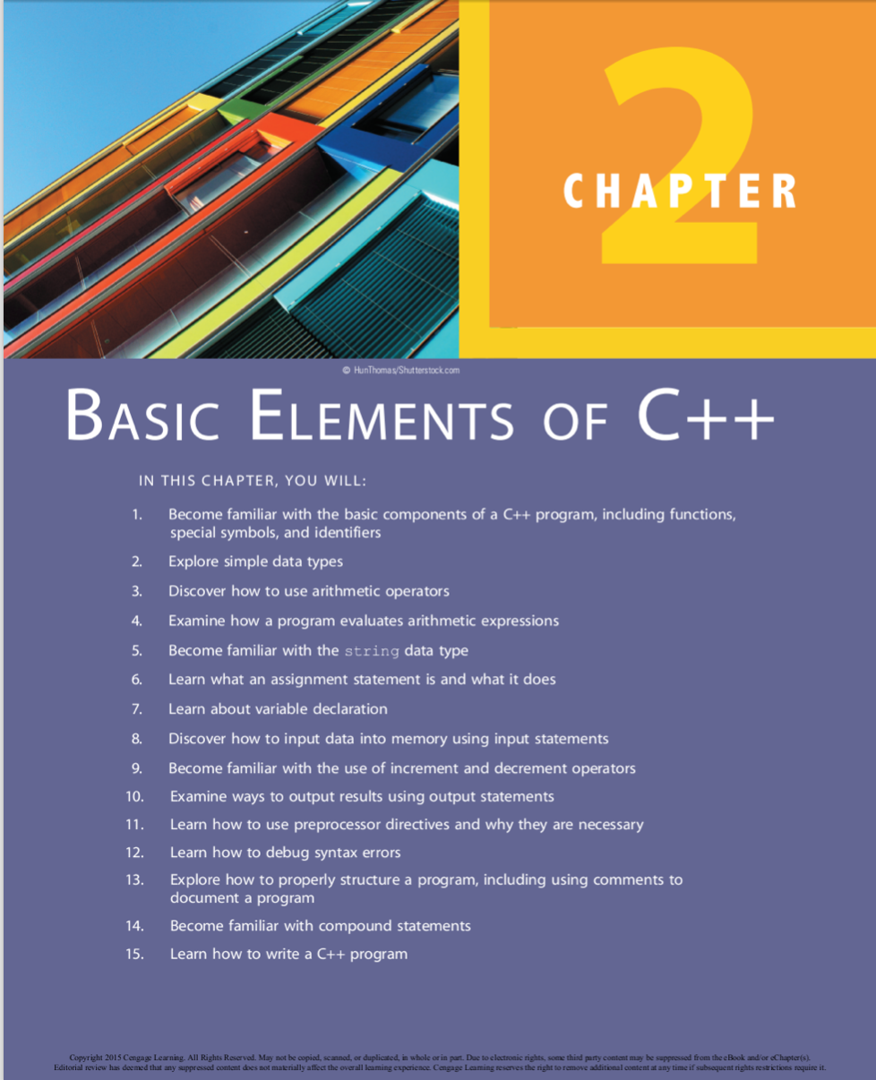

Slide 7
Introduction
Computer program
Sequence of statements whose objective is to accomplish a task
Programming
Process of planning and creating a program
Real-world analogy: a recipe for cooking

Slide 8
A Quick Look at a C++ Program
//A simple C++ program
#include<iostream>
using namespace std;
int main() {
}
Single line Comment
Header
Tells compiler to use std namespace
Main Function
cout<<“Hello World!”<<endl;
return 0;
Body of the main(), it contain the code to execute

Slide 9
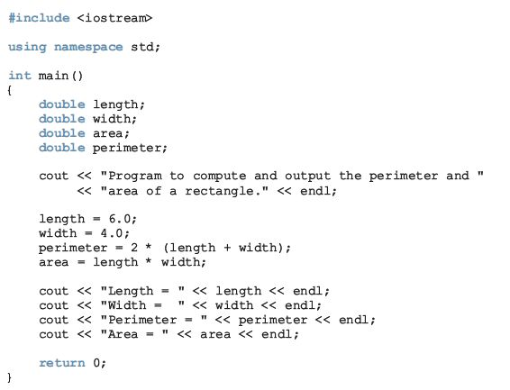
A Quick Look at a C++ Program

Slide 10
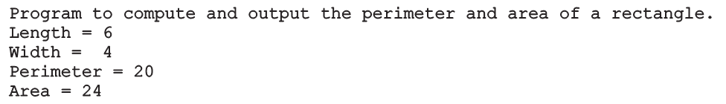
A Quick Look at a C++ Program (cont’d.)
Sample run:

Slide 11
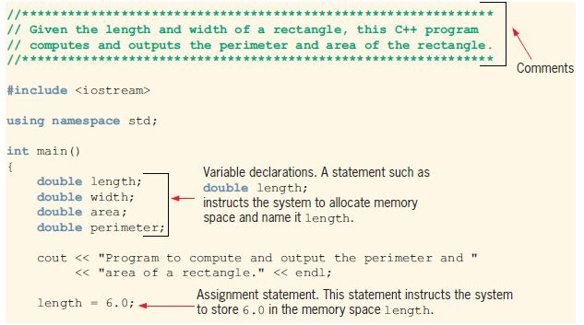
A Quick Look at a C++ Program (cont’d.)

Slide 12
A Quick Look at a C++ Program (cont’d.)

Slide 13
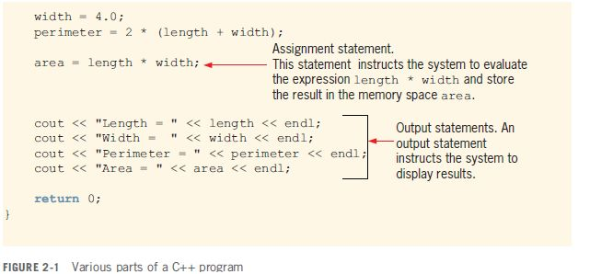
A Quick Look at a C++ Program(cont’d.)

Slide 14
A Quick Look at a C++ Program(cont’d.)

Slide 15


A Quick Look at a C++ Program (cont’d.)
Variable: a memory location whose contents can be changed
Memory allocation
Memory spaces after the statement length = 6.0; executes

Slide 16
The Basics of a C++ Program
Function (or subprogram): collection of statements; when executed, accomplishes something
May be predefined or standard
Syntax rules: rules that specify which statements (instructions) are legal or valid
Semantic rules: determine the meaning of the instructions
Programming language: a set of rules, symbols, and special words

Slide 17
Comments
Comments are for the reader, not the compiler
Two types:
Single line: begin with //
// This is a C++ program.
// Welcome to C++ Programming.
Multiple line: enclosed between /* and */
/*
You can include comments that can
occupy several lines.
*/

Slide 18
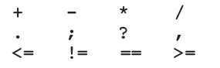
Special Symbols
Token: the smallest individual unit of a program written in any language
C++ tokens include special symbols, word symbols, and identifiers
Special symbols in C++ include:

Slide 19
Reserved Words (Keywords)
Reserved word symbols (or keywords):
Cannot be redefined within program
Cannot be used for anything other than their intended use
Examples:
int
float
double
char
const
void
return

Slide 20
Identifiers
Identifier: the name of something that appears in a program
Consists of letters, digits, and the underscore character (_)
Must begin with a letter or underscore
C++ is case sensitive
NUMBER is not the same as number
Two predefined identifiers are cout and cin
Unlike reserved words, predefined identifiers may be redefined, but it is not a good idea

Slide 21
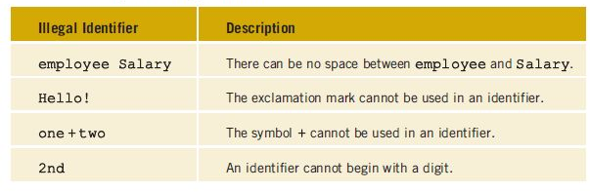
Identifiers (cont’d.)
Legal identifiers in C++:
first
conversion
payRate

Slide 22
Whitespaces
Every C++ program contains whitespaces
Include blanks, tabs, and newline characters
Used to separate special symbols, reserved words, and identifiers
Proper utilization of whitespaces is important
Can be used to make the program more readable

Slide 23
Data Types
Data type: set of values together with a set of operations
C++ data types fall into three categories:
Simple data type
Structured data type
Pointers

Slide 24
Simple Data Types
Three categories of simple data
Integral: integers (numbers without a decimal)
Can be further categorized:
char, short, int, long, bool, unsigned char, unsigned short, unsigned int, unsigned long
Floating-point: decimal numbers
Enumeration type: user-defined data type

Slide 25
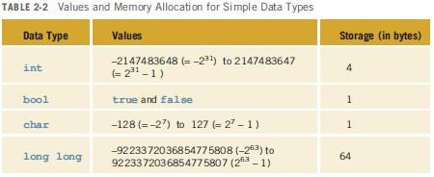
Simple Data Types (cont’d.)
Different compilers may allow different ranges of values

Slide 26
int Data Type
Examples:
-6728
0
78
+763
Cannot use a comma within an integer
Commas are only used for separating items in a list

Slide 27
bool Data Type
bool type
Two values: true and false
Manipulate logical (Boolean) expressions
true and false
Logical values
bool, true, and false(Reserved words)

Slide 28
char Data Type
The smallest integral data type
Used for single characters: letters, digits, and special symbols
Each character is enclosed in single quotes
'A', 'a', '0', '*', '+', '$', '&'
A blank space is a character
Written ' ', with a space left between the single quotes

Slide 29
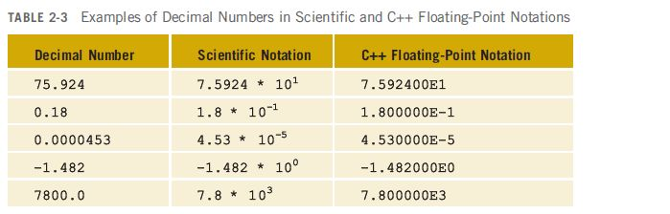
Floating-Point Data Types
C++ uses scientific notation to represent real numbers (floating-point notation)

Slide 30
Floating-Point Data Types (cont’d.)
float: represents any real number
Range: -3.4E+38 to 3.4E+38 (four bytes)
double: represents any real number
Range: -1.7E+308 to 1.7E+308 (eight bytes)
Minimum and maximum values of data types are system dependent

Slide 31
Data Types, Variables, and Assignment Statements
To declare a variable, must specify its data type
Syntax: dataType identifier;
Examples:
int counter;
double interestRate;
char grade;
Assignment statement: variable = expression
interestRate = 0.05;

Slide 32
Arithmetic Operators, Operator Precedence, and Expressions
C++ arithmetic operators:
+ addition
- subtraction
* multiplication
/ division
% modulus (or remainder) operator
+, -, *, and / can be used with integral and floating-point data types
Use % only with integral data types

Slide 33
Arithmetic Operators, Operator Precedence, and Expressions (cont’d.)
When you use / with integral data types, the integral result is truncated (no rounding)
Arithmetic expressions: contain values and arithmetic operators
Operands: the number of values on which the operators will work on.
Operators can be unary (one operand) or binary (two operands)

Slide 34
Order of Precedence
All operations inside of () are evaluated first
*, /, and % are at the same level of precedence and are evaluated next
+ and – have the same level of precedence and are evaluated last
When operators are on the same level
Performed from left to right (associativity)
3 * 7 - 6 + 2 * 5 / 4 + 6 means
(((3 * 7) – 6) + ((2 * 5) / 4 )) + 6

Slide 35
String Data Type in C++
A string data type is declared with std::string
A header <string> needs to be included at the beginning of the program.
include <iostream>
include <string>
.
.
int main(){
std::string First_Name = “Lawan”;
}

Slide 36
Expressions
Integral expression: all operands are integers
Yields an integral result
Example: 2 + 3 * 5
Floating-point expression: all operands are floating-point
Yields a floating-point result
Example: 12.8 * 17.5 - 34.50

Slide 37
Mixed Expressions
Mixed expression:
Has operands of different data types
Contains integers and floating-point
Examples of mixed expressions:
2 + 3.5
6 / 4 + 3.9
5.4 * 2 – 13.6 + 18 / 2

Slide 38
Mixed Expressions (cont’d.)
Evaluation rules:
If operator has same types of operands
Evaluated according to the type of the operands
If operator has both types of operands
Integer is changed to floating-point
Operator is evaluated
Result is floating-point
Entire expression is evaluated according to precedence rules

Slide 39
Type Conversion (Casting)
In C++, you can convert a variable from one data type to another using type casting.
There are two types of type casting: implicit type casting (also known as implicit conversion) and explicit type casting (also known as explicit conversion).
1. Implicit Type Casting: Implicit type casting happens automatically by the compiler when there is no loss of data.

Slide 40
For example, converting an integer to a float or a float to a double:
int myInt = 10;
float myFloat = myInt; // Implicit conversion to float
In this example, the integer myInt is implicitly converted to a float and assigned to myFloat.
2. Explicit Type Casting: Explicit type casting is done explicitly by the programmer, indicating explicit conversion.

Slide 41
This type of casting may result in a loss of data if the converted value cannot fit in the target data type.
To perform explicit type casting, you can use the syntax: (newDataType)value. For example:
float myFloat = 3.14;
int myInt = (int)myFloat; /*Explicit conversion from float to int*/
In this example, the float myFloat is explicitly converted to an integer using (int).
This may result in a loss of precision, as the fractional part of myFloat will be discarded.

Slide 42
string Type
Programmer-defined type supplied in ANSI/ISO Standard C++ library
Sequence of zero or more characters enclosed in double quotation marks
Null (or empty): a string with no characters
Each character has a relative position in the string
Position of first character is 0
Length of a string is number of characters in it
Example: length of "William Jacob" is 13

Slide 43
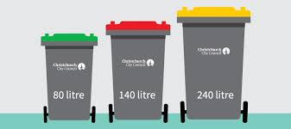
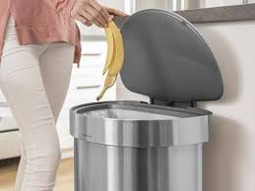
Variables, Assignment Statements, and Input Statements
Data must be loaded into main memory before it can be manipulated
Storing data in memory is a two-step process:
1. Instruct computer to allocate memory
2. Include statements to put data into memory

Slide 44
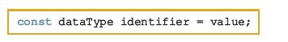
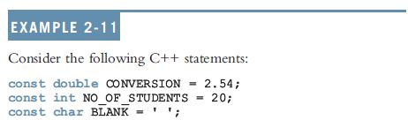
Allocating Memory with Constants and Variables
Named constant: memory location whose content can’t change during execution
Syntax to declare a named constant:
In C++, const is a reserved word

Slide 45
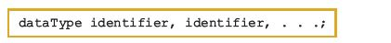
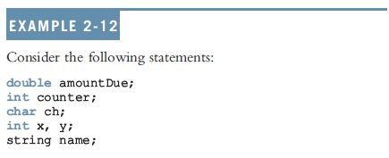
Allocating Memory with Constants and Variables (cont’d.)
Variable: memory location whose content may change during execution
Syntax to declare variable(s):

Slide 46

Putting Data into Variables
Ways to place data into a variable:
Use C++’s assignment statement
Use input (read) statements

Slide 47
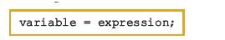
Assignment Statement
The assignment statement takes the form:
Expression is evaluated and its value is assigned to the variable on the left side
A variable is said to be initialized the first time a value is placed into it
In C++, = is called the assignment operator

Slide 48
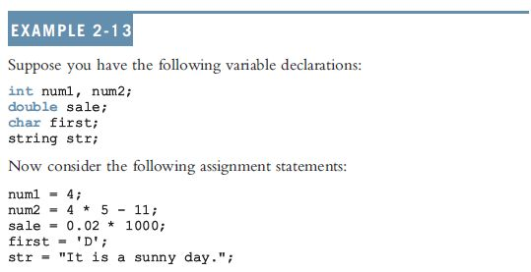
Assignment Statement (cont’d.)

Slide 49

Saving and Using the Value of an Expression
To save the value of an expression:
Declare a variable of the appropriate data type
Assign the value of the expression to the variable that was declared
Use the assignment statement
Wherever the value of the expression is needed, use the variable holding the value

Slide 50

Declaring & Initializing Variables
Not all types of variables are initialized automatically
Variables can be initialized when declared:
int first=13, second=10;
char ch=' ';
double x=12.6;
All variables must be initialized before they are used
But not necessarily during declaration

Slide 51

Input (Read) Statement
cin is used with >> to gather input
This is called an input (read) statement
The stream extraction operator is >>
For example, if miles is a double variable
cin >> miles;
Causes computer to get a value of type double and places it in the variable miles

Slide 52
Input (Read) Statement (cont’d.)
Using more than one variable in cin allows more than one value to be read at a time
Example: if feet and inches are variables of type int, this statement:
cin >> feet >> inches;
Inputs two integers from the keyboard
Places them in variables feet and inches respectively

Slide 53
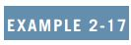
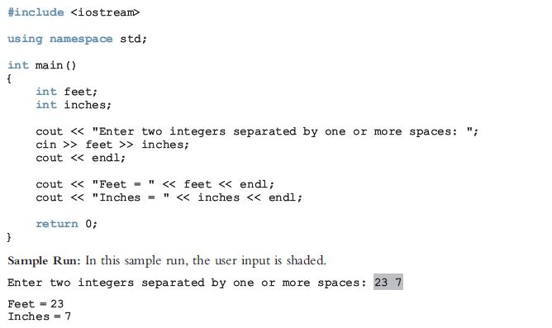

Slide 54
Increment and Decrement Operators
Increment operator: increase variable by 1
Pre-increment: ++variable
Post-increment: variable++
Decrement operator: decrease variable by 1
Pre-decrement: --variable
Post-decrement: variable—
What is the difference between the following?
x = 5;
y = ++x;
x = 5;
y = x++;

Slide 55
Output
The syntax of cout and << is:
Called an output statement
The stream insertion operator is <<
Expression evaluated and its value is printed at the current cursor position on the screen

Slide 56
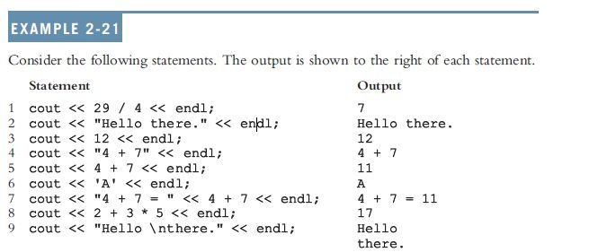
Output (cont’d.)
A manipulator is used to format the output
Example: endl causes insertion point to move to beginning of next line

Slide 57
Output (cont’d.)
The new line character is '\n'
May appear anywhere in the string
cout << "Hello there.";
cout << "My name is James.";
Output:
Hello there.My name is James.
cout << "Hello there.\n";
cout << "My name is James.";
Output :
Hello there.
My name is James.

Slide 58
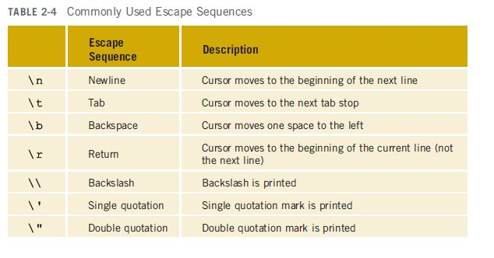
Output (cont’d.)

Slide 59
Preprocessor Directives
C++ has a small number of operations
Many functions and symbols needed to run a C++ program are provided as collection of libraries
Every library has a name and is referred to by a header file
Preprocessor directives are commands supplied to the preprocessor program
All preprocessor commands begin with #
No semicolon at the end of these commands

Slide 60
Preprocessor Directives (cont’d.)
Syntax to include a header file:
For example:
#include <iostream>
Causes the preprocessor to include the header file iostream in the program
Preprocessor commands are processed before the program goes through the compiler

Slide 61
namespace and Using cin and cout in a Program
cin and cout are declared in the header file iostream, but within std namespace
To use cin and cout in a program, use the following two statements:
#include <iostream>
using namespace std;

Slide 62
Using the string Data Type in a Program
To use the string type, you need to access its definition from the header file string
Include the following preprocessor directive:
#include <string>

Slide 63
Creating a C++ Program
A C++ program is a collection of functions, one of which is the function main
The first line of the function main is called the heading of the function:
int main()
The statements enclosed between the curly braces ({ and }) form the body of the function

Slide 64
Creating a C++ Program (cont’d.)
A C++ program contains two types of statements:
Declaration statements: declare things, such as variables
Executable statements: perform calculations, manipulate data, create output, accept input, etc.

Slide 65
Creating a C++ Program (cont’d.)
C++ program has two parts:
Preprocessor directives
The program
Preprocessor directives and program statements constitute C++ source code (.cpp)
Compiler generates object code (.o)
Executable code is produced and saved in a file with the file extension .exe

Slide 66
Debugging: Understanding and Fixing Syntax Errors
Compile a program
Compiler will identify the syntax errors
Specifies the line numbers where the errors occur
Example2_Syntax_Errors.cpp
c:\chapter 2 source code\example2_syntax_errors.cpp(9) : error C2146: syntax error :
missing ';' before identifier 'num'
c:\chapter 2 source code\example2_syntax_errors.cpp(11) : error C2065: 'tempNum' :
undeclared identifier

Slide 67
Lab Exercise
Write a program to interactively receive two integer values from the user. The program should compute the sum, difference, product, quotient, and modulo of the second by the first number. Display the results on the screen.

Slide 68
Program Style and Form: Syntax
Syntax rules: indicate what is legal and what is not legal
Errors in syntax are found in compilation
int x; //Line 1
int y //Line 2: error
double z; //Line 3
y = w + x; //Line 4: error

Slide 69
Use of Blanks
In C++, you use one or more blanks to separate numbers when data is input
Blanks are also used to separate reserved words and identifiers from each other and from other symbols
Blanks must never appear within a reserved word or identifier

Slide 70
Use of Semicolons, Brackets, and Commas
All C++ statements end with a semicolon
Also called a statement terminator
{ and } are not C++ statements
Can be regarded as delimiters
Commas separate items in a list

Slide 71
Semantics
Semantics: set of rules that gives meaning to a language
Possible to remove all syntax errors in a program and still not have it run
Even if it runs, it may still not do what you meant it to do
Ex: 2 + 3 * 5 and (2 + 3) * 5
are both syntactically correct expressions, but have different meanings

Slide 72
Naming Identifiers
Identifiers can be self-documenting:
CENTIMETERS_PER_INCH
Avoid run-together words :
annualsale
Solution:
Capitalizing the beginning of each new word: annualSale
Inserting an underscore just before a new word: annual_sale

Slide 73
Prompt Lines
Prompt lines: executable statements that inform the user what to do
cout << "Please enter a number between 1 and 10 and "
<< "press the return key" << endl;
cin >> num;
Always include prompt lines when input is needed from users

Slide 74
Documentation
A well-documented program is easier to understand and modify
You use comments to document programs
Comments should appear in a program to:
Explain the purpose of the program
Identify who wrote it
Explain the purpose of particular statements

Slide 75
Form and Style
Consider two ways of declaring variables:
Method 1
int feet, inch;
double x, y;
Method 2
int feet,inch;double x,y;
Both are correct; however, the second is hard to read

Slide 76
More on Assignment Statements
Two forms of assignment
Simple and compound
Compound operators provide more concise notation
Compound operators: +=, -=, *=, /=, %=
Simple assignment
x = x * y;
Compound assignment
x *= y;

Slide 77
Overview on Input/Outpu
Students are asked to go through chapter 3 for details on I/O in C++
cin can be used to input the value of more than one variable
The syntax is cin>>var1>>var2…

Slide 78
cin and the get Function
Ordinarily when making an input using extraction operator >> skips all the white space.
Consider the following code:
char ch1, ch2;
Int num
Now consider the following statement:
cin >> ch1 >> ch2 >> num; and that the user input:
A 25
In this case, ‘A’ is stored in ch1, the blank is skipped by the extraction operator, ‘2’ is stored in ch2, and 5 in num

Slide 79
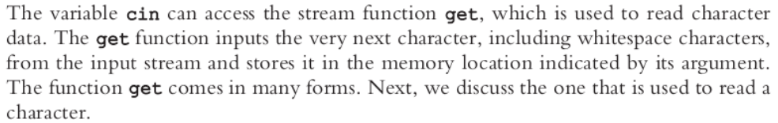
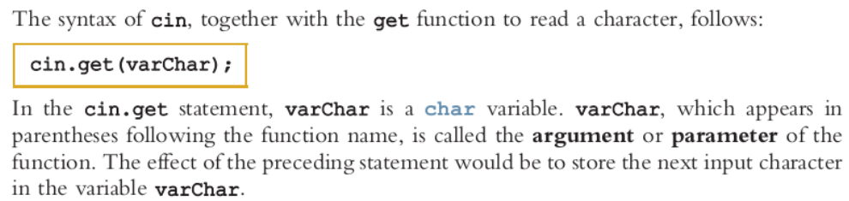
It is now obvioius that we can not use the extraction operator to input such data.

Slide 80
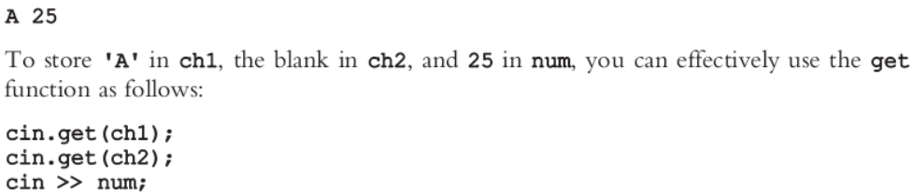
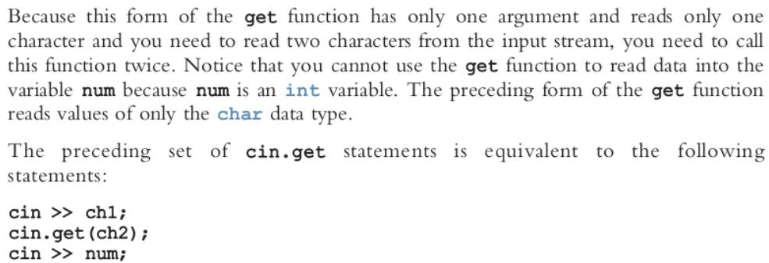
Now, consider the following input again:

Slide 81
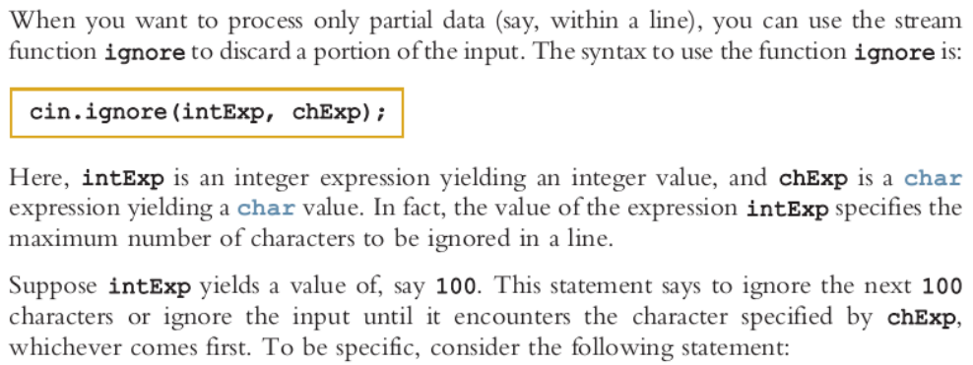
cin and the ignore function

Slide 82
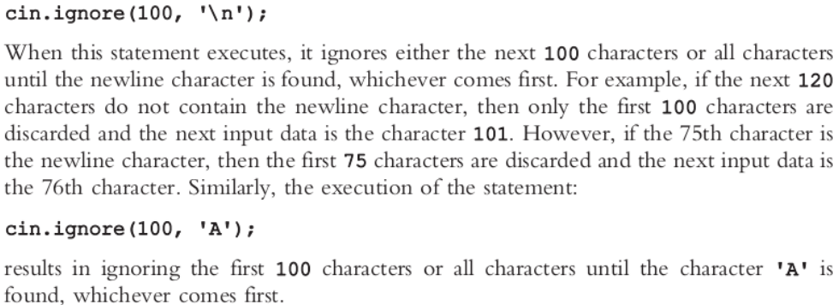

Slide 83
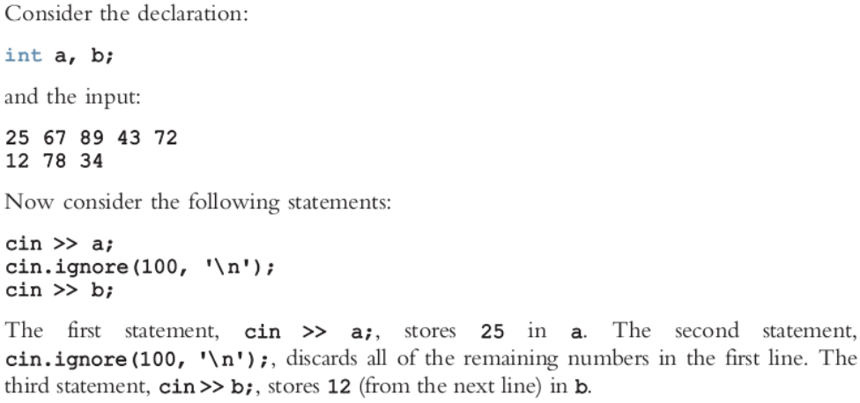

Slide 84
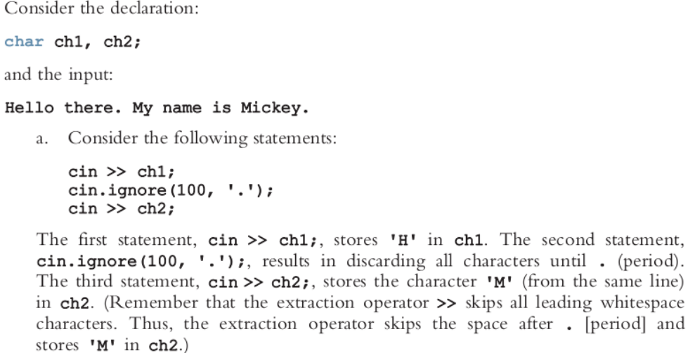

Slide 85
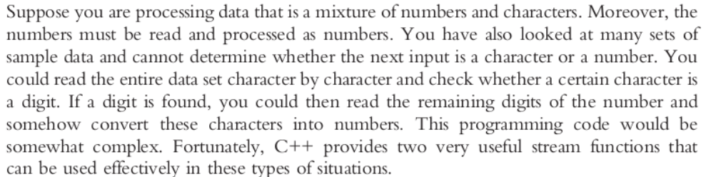
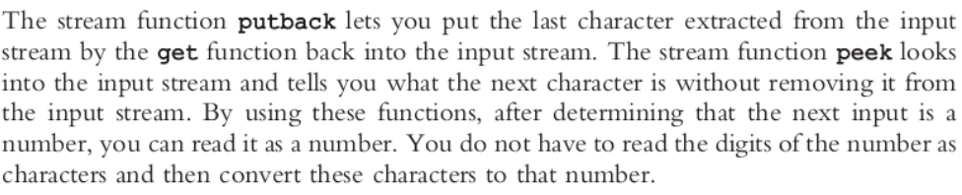
The putback and peek Functions

Slide 86
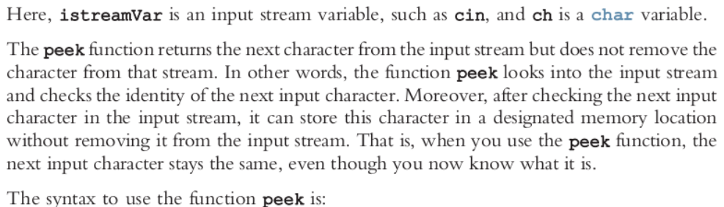
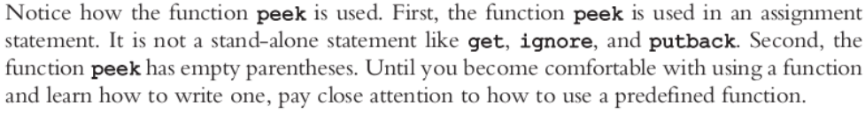
The syntax to use the function putback is:
cin.putback(ch);
ch = cin.peek();

Slide 87
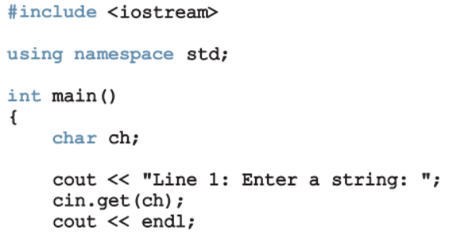
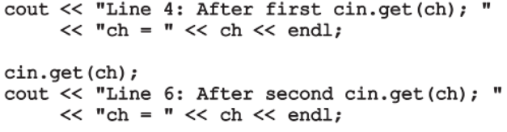
The following program demonstrate how to use putback() and peek() functions

Slide 88
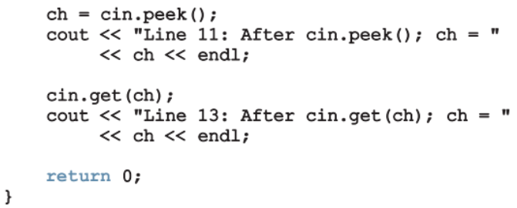
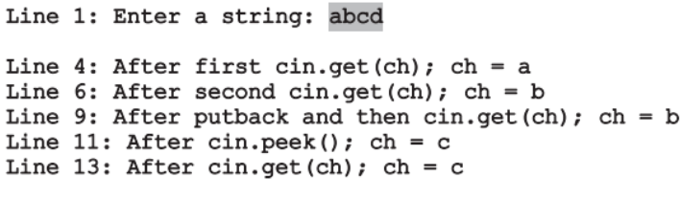
In this sample run, the user input is shaded:

Slide 89
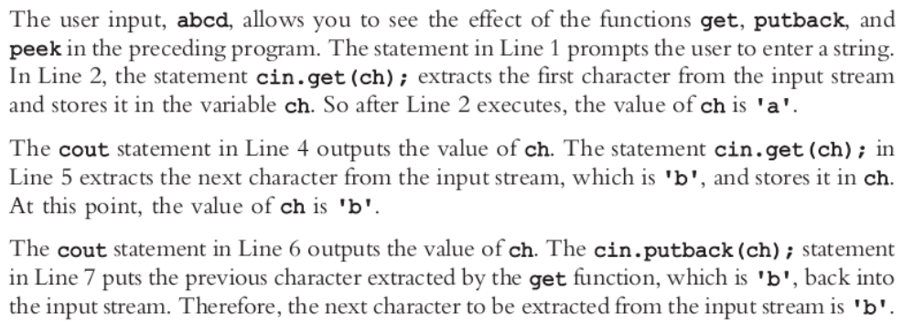
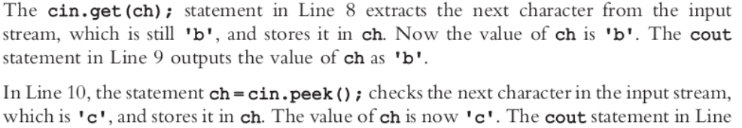

Slide 90
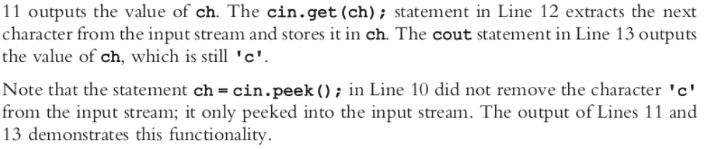

Slide 91
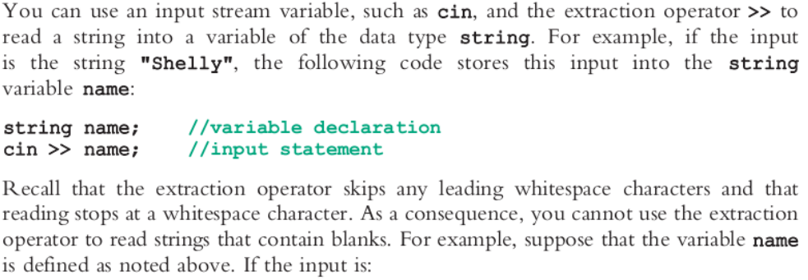
Input/Output and the string Type

Slide 92
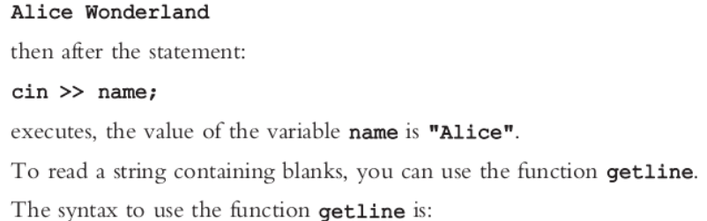
getline(cin, strvar)
The function getline reads until it reaches the end of the current line. The newline character is also read but not stored in string variable.

Slide 93
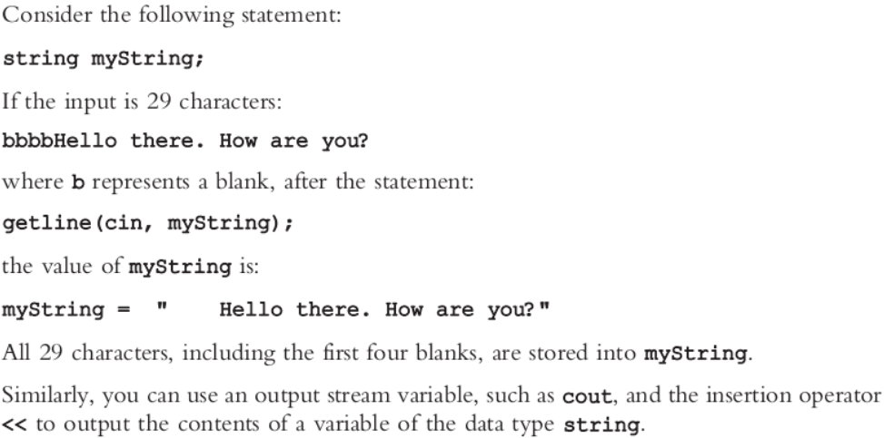

Slide 94
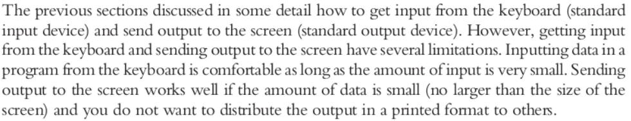
File Input/Output
Generally, five steps are followed in order to input and output file in C++, they are as follow go and read them in chapter 3 as assignment:

Slide 95
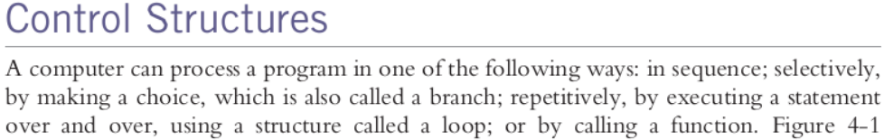
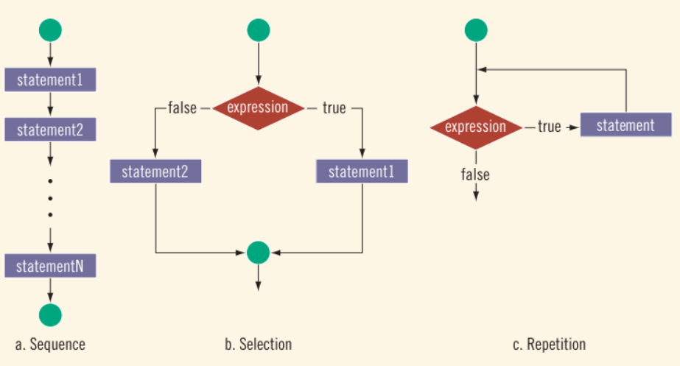

Slide 96



Slide 97

One-way Selection
The syntax of one way selection is:
if (expression)
statement;

Slide 98

Ignore 2nd and 11th lines for now

Slide 99



Slide 100


Slide 101


Slide 102



Slide 103

Consider the following statements:
if (hours > 40.0)
wages = 40.0 * rate + 1.5 * rate * (hours – 4.0);
else
wages = hours * rate;
Transform the above into fully stand alone program

Slide 104

The following statements show an example of a syntax error, indicate the line

Slide 105


Slide 106



Slide 107


Slide 108


Slide 109


Slide 110


Slide 111


Slide 112


Slide 113



Slide 114

Logical (Boolean) Operators and Logical Expressions
We earlier shown how we can incorporate selection statement in a program.

Slide 115


Slide 116


Consider the following example:

Slide 117



Slide 118


Slide 119



Slide 120


Slide 121


Slide 122



Slide 123



Slide 124


Slide 125

binary operators.
evaluating operators.

Slide 126

Precedence of Logical Operators:

Slide 127

Compound (Block of) Statements
In both if, and if…else you can have more than one statement to execute if the condition is true. In that case you enclose the statements in curly braces to form compound statements:

Slide 128


Consider the following example:

Slide 129

More example on the nested if in the book.

Slide 130


Conditional Operator (? :)

Slide 131


Switch Structure

Slide 132


Slide 133

Consider the following code snippet in which the grade is the variable of char type:

Slide 134


Slide 135


Slide 136


Slide 137

Execute the above program severally to see the effect of the “break” keyword

Slide 138


Slide 139



Slide 140



Slide 141



Slide 142



Slide 143



Slide 144


Slide 145


Slide 146


Slide 147



Slide 148


Slide 149



Slide 150


Slide 151



Slide 152

And over until certain conditions are reached.

Slide 153


Slide 154



Slide 155


Slide 156


as the expression (i <= 20) evaluates to true.

Slide 157


Slide 158


Slide 159


Slide 160

The following example demonstrated the usage of counter-controlled while loop:

Slide 161


Slide 162


Slide 163



Slide 164


Slide 165


of the for statement.

Slide 166


Slide 167



Slide 168



Slide 169


Slide 170


Slide 171


Slide 172



Slide 173



Slide 174



Slide 175


Slide 176


Slide 177



Slide 178




Slide 179
Summary
C++ program: collection of functions, one of which is always called main
Identifiers consist of letters, digits, and underscores, and begins with letter or underscore
The arithmetic operators in C++ are addition (+), subtraction (-), multiplication (*), division (/), and modulus (%)
Arithmetic expressions are evaluated using the precedence associativity rules

Slide 180
Summary (cont’d.)
All operands in an integral expression are integers
All operands in a floating-point expression are decimal numbers
Mixed expression: contains both integers and decimal numbers
Use the cast operator to explicitly convert values from one data type to another
A named constant is initialized when declared
All variables must be declared before used

Slide 181
Summary (cont’d.)
Use cin and stream extraction operator >> to input from the standard input device
Use cout and stream insertion operator << to output to the standard output device
Preprocessor commands are processed before the program goes through the compiler
A file containing a C++ program usually ends with the extension .cpp

